Slide 1

Welcome to Lime Class
Year 1 and 2

Slide 2
Who’s Who?
Class Teacher
Miss Taylor
Teaching Assistant
Mrs Hunt
Supports every morning
1:1 Teaching Assistant
Ms Jones
PPA cover
Mrs Thompson
Class Email Address: limeclass@longleaze.wilts.sch.uk
Class Web Pages: www.longleaze.wilts.sch.uk/classes/

Slide 3
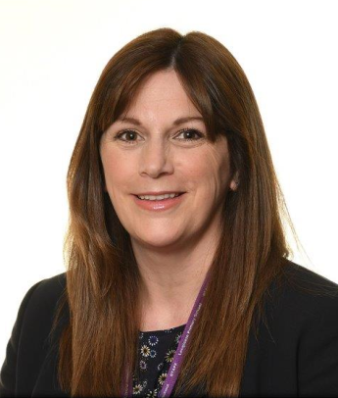

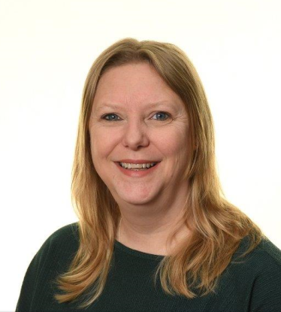
Other Key Staff
Mrs Webb
ELSA
Mrs Oakes
Headteacher
Mr Yeo
Deputy Headteacher
Mrs Thompson
SENCO

Slide 4
Safeguarding Team
Designated Safeguarding Lead – Mrs Oakes
Deputy Designated Safeguarding Lead- Mr Yeo
Safeguarding Governor – Mrs Esther Webb
Chair of Governors – Mr John Williams
Child Mental Health Leads – Mrs Thompson and Mr Yeo

Slide 5

Class Topics
Topics:
Term 1 – Saving the World by Lunchtime
Term 2 – Welcome to the Toy Shop
Term 3 – London’s calling
Term 4 – London’s Burning!
Term 5 – A Place in the Sun
Term 6 – Passport Around the World
Trips: Walk into town, Fire of London theatre group visit, Bristol Zoo Project trip (term 5)

Slide 6
Homework
Each week pupils:
will be expected to read on at least 3 occasions;
will be given a spelling, grammar or phonics activity;
will be given a maths task that is linked to the learning going on in the class that week.
Homework will now all be given on one sheet at the beginning of the term with an activity for each week. Phonics sheets will go out weekly with the sounds we have learnt that week.
In addition to this, each term, pupils will also have the opportunity to complete one piece of optional creative homework that is linked to their class topic. This will be shared with the class at the end of the term.
Homework goes home on a Friday and to be returned by Wednesday.

Slide 7
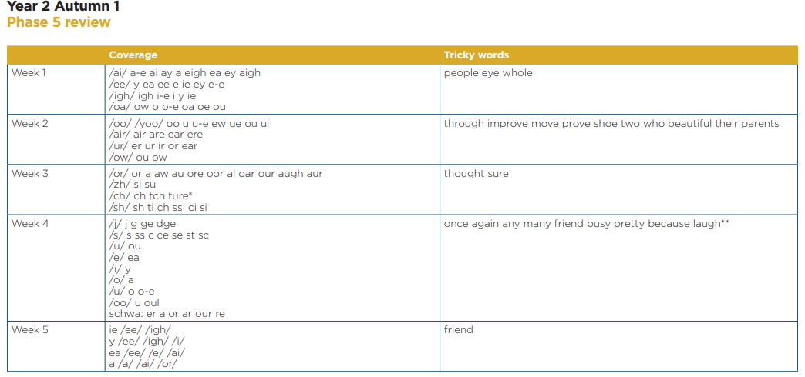
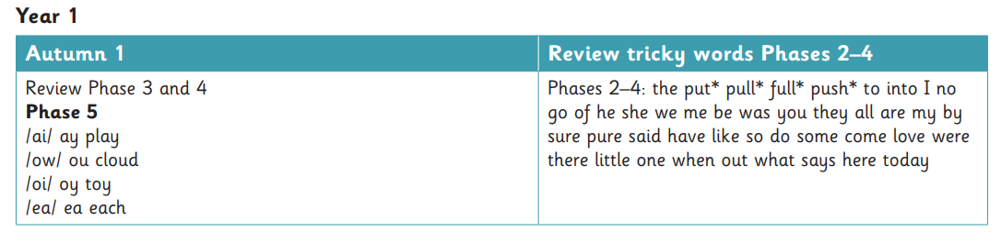
Phonics
Phonics teaching is essential for successful reading and is taught daily in KS1.
In each lesson children will learn new sounds, recall sounds they have previously learnt, practise word and sentence reading and spelling.
The skills are also practised throughout the day in reading and writing lessons.
You can find out what your child is learning each term on the initial homework sheet which looks like this:
    More information can be found on the school or Little Wandle website. There are lots of videos to help with pronunciation and suggestions of ways to support your child.
    At the end of year one children will complete a statutory phonics screening test. This will take place in June.

Slide 8
Reading
Your child will take part in a reading practise session three times a week.
These small group sessions will have a different focus each day – decoding, prosody and comprehension.
Your child will bring the book home that they have been reading in class on a Thursday.
The emphasis is on reading fluency – being able to read most words without having to pause and sound them out.
Books are now very closely matched to what is being taught in class and your child’s ability to read fluently. You may find that your child appears to have easier books but please help them to practise at home to be able to recognise the words on sight.
    Your child will also choose a ‘home sharing book’ from the library each week which has a blue sticker. These are for you to share and enjoy together.

Slide 9
KS1 Healthy Snack
In Key Stage 1 children are provided with a piece of fruit at snack time. Milk is also available on request.
You may wish to provide your child with a snack. This should be a fruit or vegetable snack, cheese string, yoghurt or a healthy cereal bar.
Our healthy school’s policy also states that children should have water in their water bottles. This does not contain sugars or sweeteners like juice and squash do. It also does not stain children’s work if spilled in the classroom.

Slide 10
Physical Education (PE)
This term PE will be on Monday and Thursday:
It is a legal requirement and for health and safety reasons children are not allowed to participate without the correct PE kit.
Please ensure that your child comes to school in their PE kit on this day.
Correct kit:
Black shorts
White or purple t-shirt
Hair must be tied up
    Earrings must be covered, and watches removed

Slide 11
Year 2 SATs
KS1 SATs are now non-statutory and optional.
We may use past papers as part of evidence gathering to inform our teacher assessment at the end of the year but will do this informally so that no undue pressure is placed on the children.

Slide 12
Any questions?
Please feel free to have a look around the classroom.

