Slide 1

Welcome to Chestnut Class
Year 2
Notes:
Welcome and explain who TAs are
Explain that adults will work with all children

Slide 2
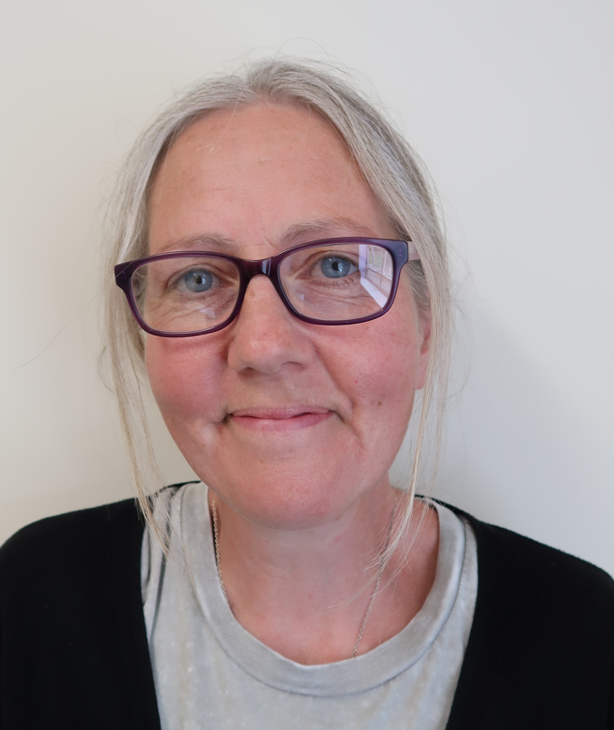
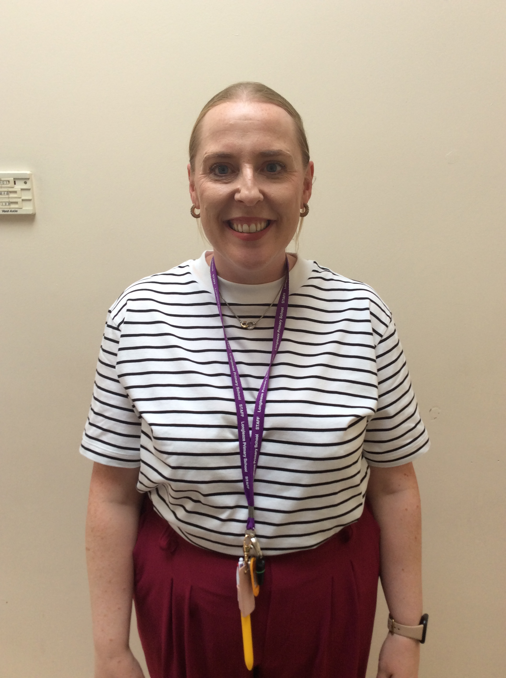
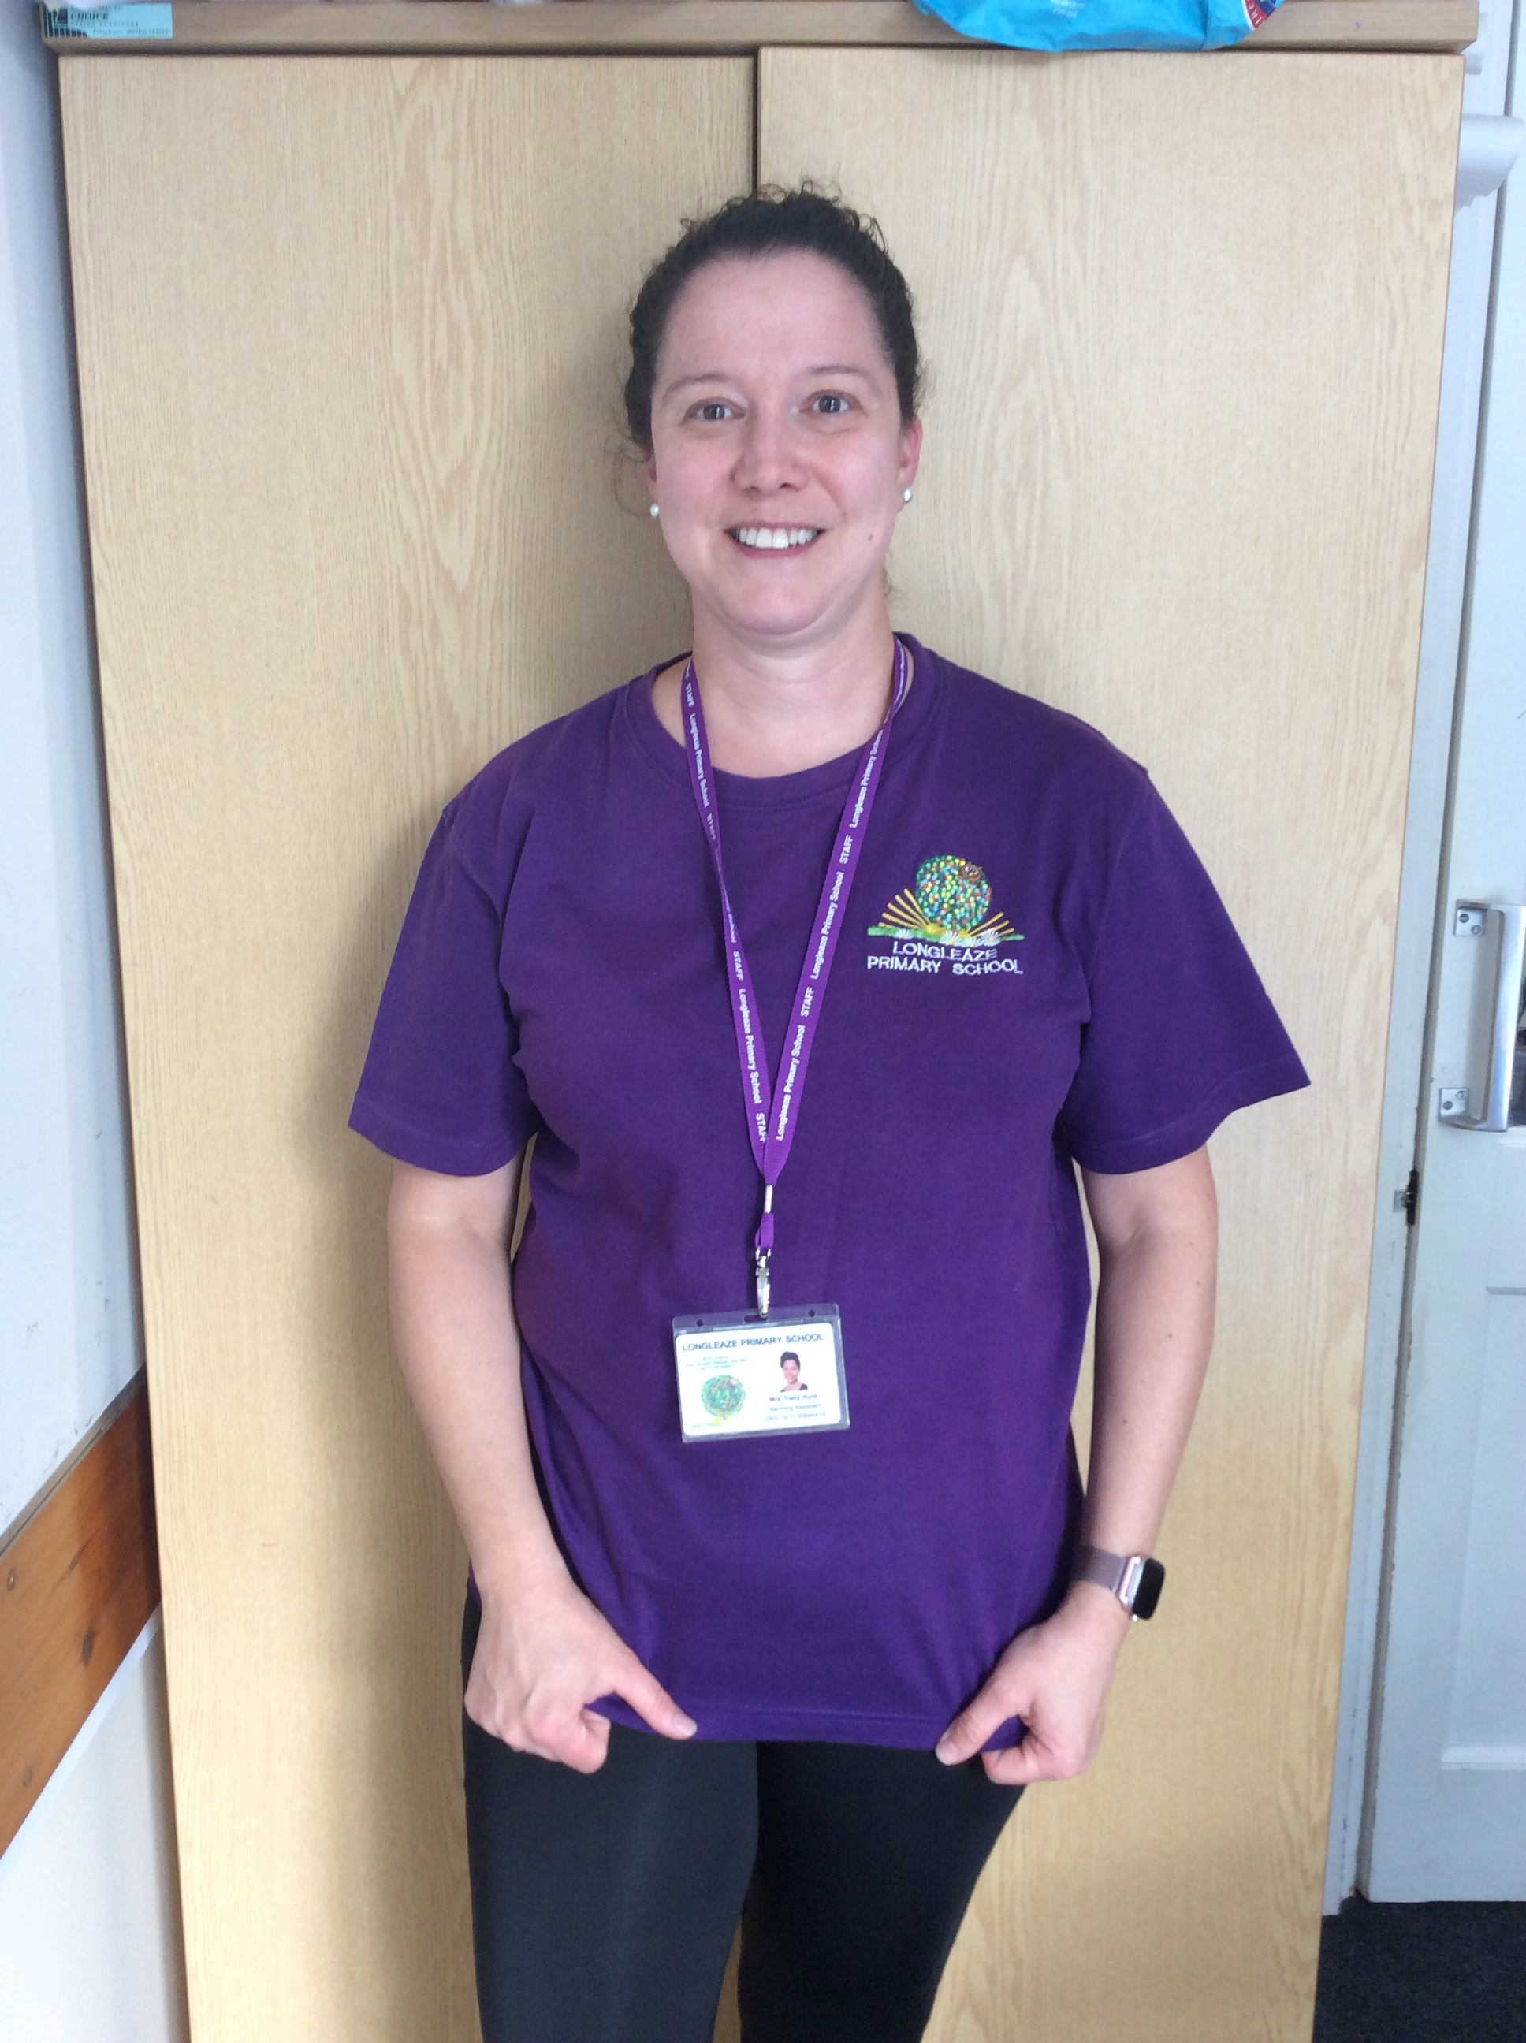
Mrs Taylor
Teaches Thursdays and Fridays
Mrs Richardson
Supports every morning
Mrs Hunt
Supports every afternoon
Who’s who?

Slide 3
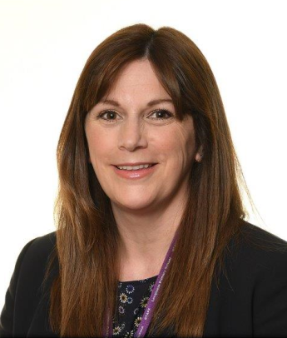
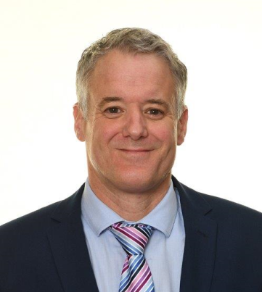
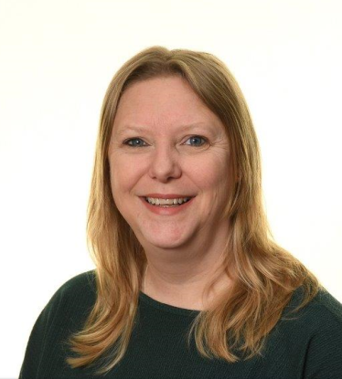
Mrs Oakes
Headteacher
Mr Yeo
Deputy Headteacher
Mrs Thompson
SENCO
Mrs Webb
ELSA
Other Key Staff

Slide 4
Safeguarding Team
Designated Safeguarding Lead – Mrs Oakes
Deputy Designated Safeguarding Lead- Mr Yeo
Safeguarding Governor – Mrs Esther Webb
Chair of Governors – Mr John Williams
Child Mental Health Leads – Mrs Thompson and Mr Yeo

Slide 5

Daily routines
Daily phonics and spelling
Reading practise 3x weekly
Daily literacy and mathematics sessions
Range of curriculum subjects in the afternoon linked to the topic
PE 2x weekly – Mondays and Fridays this term
Morning playtime will take place at 10.20am
Lunchtime will take place at 12pm. The children will play outside until 12.30pm and then eat lunch in the hall until 1pm

Slide 6
Phonics and Spelling
In Year 2 we move onto the Little Wandle spelling programme.
This term the children will recap the Phase 5 sounds that they learnt in Year 1 and practise word and sentence reading and spelling.
For children that have not secured phase 5 they will work in a small group to do this before moving on to spelling.
The lessons follow a similar structure every day with a review lesson each Friday.
The skills are also practised throughout the day in reading and writing lessons.
Children are regularly assessed and any gaps are filled during the afternoon by Mrs Hunt.
More information can be found on the school or Little Wandle website. There are lots of videos to help with pronunciation and suggestions of ways to support your child.

Slide 7
Reading
Your child will take part in a reading practise session three times a week.
These small group sessions will have a different focus each day – decoding, prosody and comprehension.
Your child will bring the book home that they have been reading in class on a Thursday.
The emphasis is on reading fluency – being able to read most words without having to pause and sound them out.
Books are very closely matched to what is being taught in class and your child’s ability to read fluently. You may find that your child appears to have easier books but please help them to practise at home to be able to recognise the words on sight.
    Your child will also choose a ‘home sharing book’ from the library each week which has a blue sticker. These are for you to share and enjoy together.

Slide 8
Topics this year
Topics:
Term 1 – Saving the World by Lunchtime
Term 2 – Welcome to the Toy Shop
Term 3 – London’s calling
Term 4 – London’s Burning!
Term 5 – A Place in the Sun
Term 6 – Passport Around the World
Trips: Walk into town, Fire of London theatre group visit, Bristol Zoo Project trip (term 5)

Slide 9
Homework
Each week pupils:
will be expected to read on at least 3 occasions;
will be given a spelling, grammar or reading comprehension activity;
will be given a maths task that is linked to the learning going on in the class that week.
Homework will now all be given on one sheet at the beginning of the term with an activity for each week.
In addition to this, each term, pupils will also have the opportunity to complete one piece of optional creative homework that is linked to their class topic. This will be shared with the class at the end of the term.
Homework goes home on a Friday and should be brought in on a Wednesday.

Slide 10
KS1 Healthy Snack
In Key Stage 1 children are provided with a piece of fruit at snack time. Milk is also available on request.
You may wish to provide your child with a snack. This should be a fruit or vegetable snack, cheese string, yoghurt or a healthy cereal bar.
Our healthy school’s policy also states that children should have water in their water bottles. This does not contain sugars or sweeteners like juice and squash do. It also does not stain children’s work if spilled in the classroom.

Slide 11
Year 2 SATs
KS1 SATs are now non-statutory and optional.
We may use past papers as part of evidence gathering to inform our teacher assessment at the end of the year but will do this informally so that no undue pressure is placed on the children.

Slide 12
Any questions?
Please feel free to have a look around the classroom.

